Slide 1



Lawrence Partnership for Transition to Employment (LPTE)
Allison Taylor (ICI)
Esther Kamau (ICI)
Rowan DeAza (The Arc of GHN)
Notes:
Allison

Slide 2


About the LPTE
The Lawrence Partnership for Transition to Employment (LPTE) was established in 2021 under a 5-year grant from the Administration for Community Living (ACL) as a National Center of Excellence on Community Collaborations for Employment.
The project aims to improve the transition process for youth with intellectual and developmental disabilities (ID/DD) in Lawrence, Massachusetts.
Notes:
Allison
→ Rowan

Slide 3



Goals of the LPTE
Better transition outcomes for youth
Improved processes and experiences for youth and families
Enhanced collaboration among local partners
Notes:
Rowan
The LPTE has three interrelated goals :
1) To improve collaboration among local partners, leading to
2) Improved transition processes and experiences for youth and families and
3) Improved transition to work outcomes for youth with ID/DD in Lawrence.
→ Esther

Slide 4
6 Principles of Collaborating for Equity & Justice
The six principles are: | LPTE will:
Directly address race, ethnicity, and social class. | Talk openly about these things, starting with this meeting.
Give equal power to community members in deciding what’s important to work on. | Listen to parents, students, and other people in Lawrence when deciding what to put in our strategic plan.
Work to build leadership and power among community members. | Include parents and students as paid team members in all project work.
Focus on changing whole systems, not just local programs. | Learn from people in Lawrence how state and national policies can be better for families.
Look to research on what works. | Use existing tools to measure how we are doing.
Support the group members to lead the work. | Use ICI and Arc staff to support what the consortium wants to do.
Notes:
Esther

Slide 5
LPTE Structure
Steering Committee
Core Team
Consortium
Consortium
  Meets quarterly
  Guides overall work of the project
Steering Committee
  Meets several times a year
  Advises on project activities
  Discusses emerging themes
Core Team
  Meets biweekly
  Work Groups
  Develop and implement project goals
Notes:
Esther
Who are the members of the LPTE? Staff from the Arc of Greater Haverhill-Newburyport and the Institute for Community Inclusion at UMass Boston form the LPTE core team. The Steering Committee which is comprised of the Core team, key community members and professionals. The Consortium is made up of 90 members including both Core and Steering teams. Quarterly LPTE Consortium meetings guide the overall work of the project. The full consortium has provided initial input on resources and challenges; engaged in discussions on cross-cultural collaboration, provided guidance on the Community Landscape Analysis structure and the community conversations process; as well as reviewed and provided input on emerging themes after the conversations.
Monthly LPTE Steering Committee meetings are held to establish the process for generating the Community Landscape Analysis, consult on logistical details, and discuss emerging themes throughout the process. The committee is composed of 13 members, including a self-advocate, the Bilingual Family Support Navigator from the Arc of Greater Haverhill-Newburyport, the Massachusetts Developmental Services (DDS) Lawrence area director, the transition specialist and a multilingual learner family engagement specialist from Lawrence Public Schools, a counselor from the Massachusetts Rehabilitation Commission, and the senior project director from Mass Advocates for Children, a non-profit children's advocacy group.

Slide 6








Who are the members of the LPTE Consortium?
Local:
Self-advocates and parents/families
Mayor’s office, ADA coordinator
Public schools, community college
Family advocacy groups
Employment collaborative
Independent Living Center
Local nonprofits
State and regional:
Workforce Center
Department of Developmental Services
State VR agency
Regional transportation authority
Children’s advocacy center
LPTE
Consortium
Notes:
Esther
LPTE brings together a diverse range of stakeholders from different sectors and organizations to form the consortium. The group includes
The Core and steering teams
Self-advocates
Family members
Members of the public school's Special Education Parent Advisory Council.
Representatives from the mayor's office, including the ADA coordinator
Personnel from local high schools, the technical school, educational collaborative, community college, and 4-year college.
Included, too, are local family advocacy groups, employment collaboratives, the independent living center, and the regional transportation authority. At the regional and state level, the consortium includes Mass Advocates for Children, a children's advocacy center, the MassHire workforce center, Social Security, the state's Department of Developmental Services, and the Massachusetts Rehabilitation Commission
→ Allison

Slide 7
LPTE Process
Community Landscape Analysis
Strategic Priorities
Work Groups – Plan and Implement
Community Conversations
Consortium
Notes:
Allison
The LPTE stared in 2021
First step: hold community conversations to understand the strengths and goals related to the transition process in Lawrence.
From that process, we developed a Community Landscape Analysis, which was presented to the Consortium
Then we returned to the Consortium to identify the most important strategic priorities and
formed work groups to address those priorities.
The LPTE Consortium is the core of the project. At every step, the Consortium is providing input, making decisions, and shaping the direction of the LPTE. One of the issues identified in the Community Landscape Analysis was that there are a lot of resources and providers in Lawrence, but they don’t always talk to each other or to parents and families. The LPTE Consortium helps foster better collaboration by providing opportunities for everyone to come together, get to know each other, and discuss solutions.
→ Oliver

Slide 8
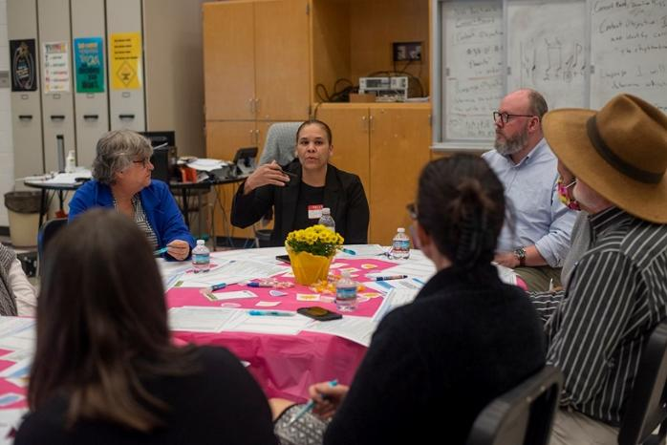
Community Conversations
Community conversations were held to gather perspectives of community members. We asked:
  What outcomes are important for youth with disabilities in Lawrence when they leave school?
  What 1 or 2 things would help youth with disabilities find employment when they leave school?
  What 1 or 2 strengths in the Lawrence community could help youth with disabilities find employment?
  In 4 years, what services, supports, and opportunities for work would you like to see for youth with disabilities in your community?
Notes:
Community Conversations were held in November 2022.
Rowan
We hosted community conversations in various community locations to discuss community needs regarding transition planning. One of the things we noticed immediately was the lack of trust families had for systems and organizations. We had a lot of feedback from service provider professionals but had minimal family and student participation. Due to this we revised our strategy and went into the schools and brought the conversation to the students as well as Lawrence families that called into or visited our organization. Once we collected the data needed the CLA was developed. This helped us identify strategic priorities and the development of the work groups.
Each conversation was guided by four questions:
1) What outcomes do you think are important for youth with disabilities in Lawrence when they leave school?
2) What are 1 or 2 things that would help youth with disabilities find employment when they leave school?
3) What are 1 or 2 strengths within the Lawrence community that could help youth with disabilities find employment?
4) In four years, what services, supports, and opportunities for work would you like to see for youth with disabilities in your community?

Slide 9
Community Landscape Analysis (CLA):
Summary of Findings
Feedback obtained through community conversations and other information gathering sessions centered on three major themes:
the most important outcomes for youth with disabilities in Lawrence.
the strengths of the community that can be an asset to transitioning youth.
recommended strategies for the LPTE.
Notes:
In March 2023, we presented our findings on these three themes to the full Consortium and facilitated a discussion to get feedback and input into a) what’s missing, b) what areas to prioritize, and c) ideas on strategies.

Slide 10
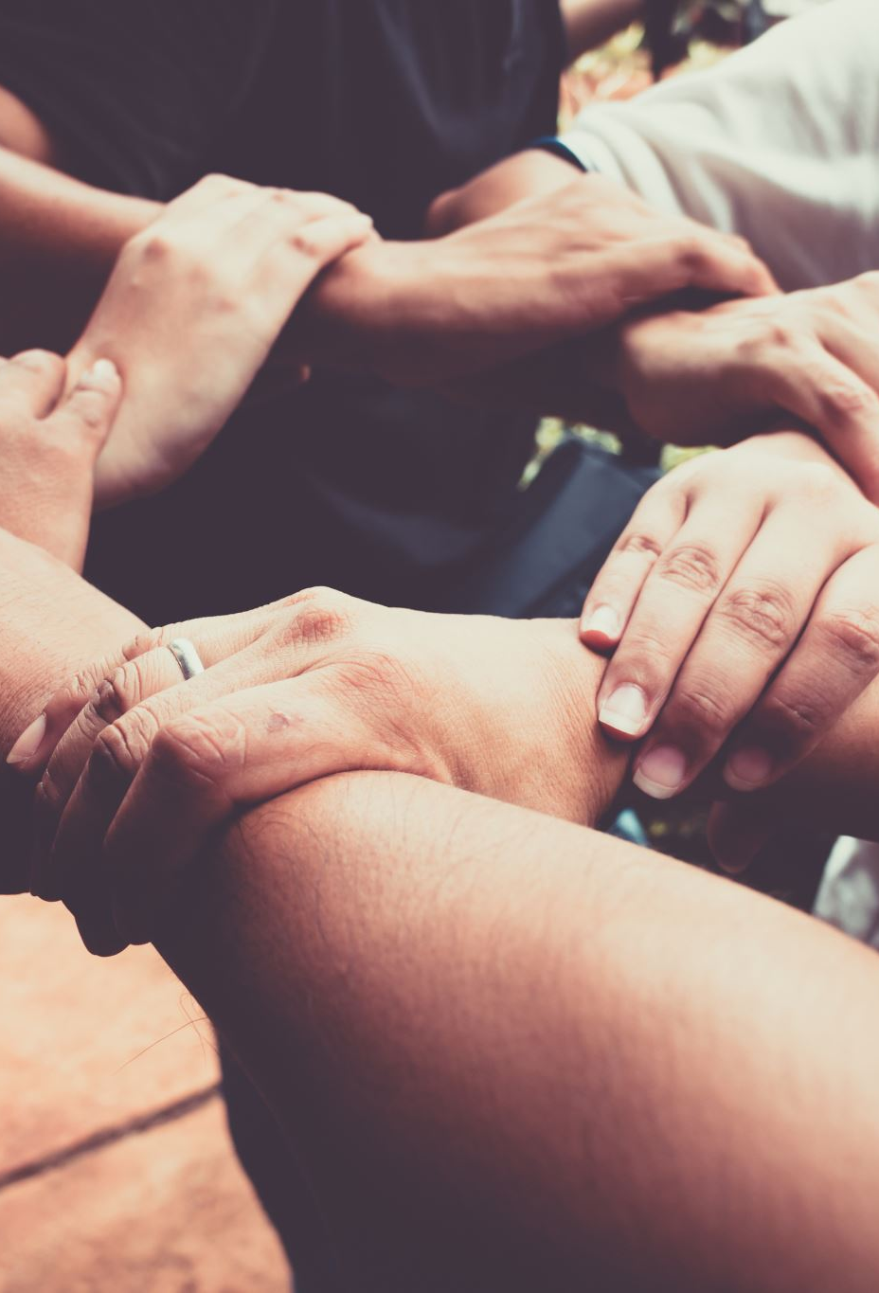
1. Most Important Outcomes for Youth
Identifying and working toward their own goals
Competitive Integrated Employment
Community engagement and relationships
Gaining skills
Ongoing supports
Having a team like they did in school
Champion, coach, or mentor (professional or family/friend)
Notes:
Each community conversation opened with the question, “What outcomes do you think are important for youth with disabilities in Lawrence when they leave school?” The following themes emerged from those discussions.

Slide 11

2. Strengths of the Community
Community values and culture
Disability services
Community resources
Local businesses
Engaged parents and family members
Personal strengths of youth with disabilities
Notes:
Rowan
Conversation participants were also asked to name “one or two strengths within the Lawrence community that could help youth with disabilities find employment.” Identified strengths included:

Slide 12

3. Strategic Priorities
Strategic Priorities Summary
Discussed 9 priorities at a Consortium meeting
Improve the handoff from school to adult services.
Foster better cross-agency connections.
Offer more work experiences while in school.
Prepare students for employment in other ways.
Prepare students for other aspects of adult life.
Partner with families.
Hire more bilingual/multilingual staff at local service provider agencies.
Engage local businesses.
Provide more after-school and weekend options.
Use DOTS to vote for your top 5 priorities.
Use STICKY NOTES for the top 2–3 you want to work on.
Notes:
This shows a slide from our June 2023 Consortium meeting presentation.
Presented 9 priority areas identified in the Community Landscape Analysis, with examples and strategies to consider.
Facilitated a discussion about the priorities and then posted them around the room. Consortium members got:
dots to vote on their 5 top priorities.
sticky notes to put their names on 2-3 they want to work on
We analyzed the votes, and through discussions with the Core Team and Steering Committee, identified 4 priority areas.

Slide 13
Strategic Priorities:
Work Groups
Improve the handoff and foster better cross-agency connections
Offer more work experiences while in school
Prepare students for other aspects of adult life
Partner with families

Slide 14
2025-2026 Activities
Parent/Family Engagement
Resource Hub
Employment Stories
Sustainability Planning

Slide 15

Family Survey
Partnering with Families workgroup members designed short survey
Initial distribution through the LPTE Consortium got minimal response
Partnering with Lawrence Public School resulted in over 200 responses
Notes:
Recognizing the need to hear directly from families about the transition process, the Partnering with Families work group created a short survey for families who had students with disabilities enrolled in Lawrence Public Schools.
Collaboration with Lawrence Public Schools resulted in over 200 families responding to the survey.

Slide 16
Family Survey: Findings
Families value transition planning and IEP participation, but face barriers:
Families want information about transition earlier.
Families expect their students to pursue employment after high school — but only 12% report their high schoolers are getting pre-employment training.
Notes:
Families value transition planning and IEP participation, but face barriers:
Scheduling conflicts
Language
Childcare
Accessibility challenges with Zoom meetings
Lack of clarity about IEPs
Family expectations
Families want information about transition earlier.
Families expect their students to pursue employment after high school — but only 12% report their high schoolers are getting pre-employment training.
Visibility of Transition Supports
LPS offers a strong set of transition services, but families, educators, and partners are often unaware of what’s available or how to access it.
Families and partners called for clearer, more accessible communication.

Slide 17
Parent/Family Engagement
LPTE's Partnering with Families Workgroup worked with Lawrence Public Schools to host a Winter Series on the transition planning process.
  Panel presentation on what services agency provides
  Opportunity for parents to engage one on one with agencies.
The Lawrence public school provided Spanish interpretation, childcare, and refreshments.
Provider agencies provided items for a raffle to incentivize attendance.
Notes:
The series included a panel presentation for parents
Lawrence Public Schools
The Arc of Greater Haverhill-Newburyport
Massachusetts Advocates for Children
Northeast Independent Living Program
Massachusetts Advocates Standing Strong
Lawrence Welcome center
A parent advocate

Slide 18
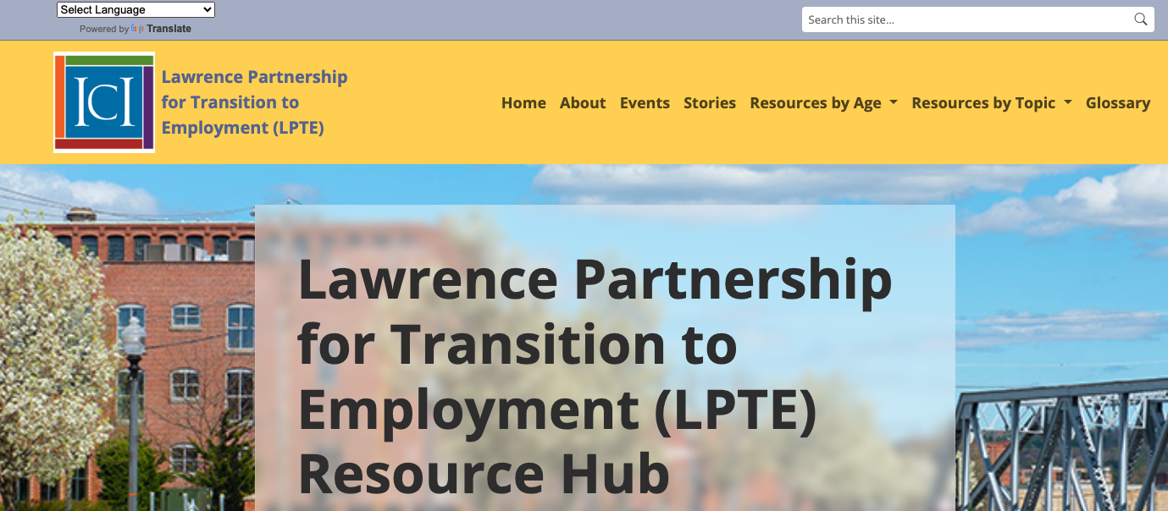
Emerged from the Preparing Students for Other Aspects of Adult Life work group.
Lawrence has a lot of great transition resources, but students and parents can't find them.
LPTE Consortium contributed resources, input, and feedback.
The online Resource Hub and in-person Merrimack Valley Welcome Center complement each other.
Notes:
The LPTE Resource Hub emerged from an idea that the Preparing Students for Other Aspects of Adult Life work group had, which was that Lawrence didn't need new transition resources, rather, its students and parents just needed easy access to all of the existing resources. This idea was adopted by the whole of the LPTE and eventually became the online Resource Hub that will go live this Spring.
One Consortium member had the idea of creating a physical version of the Resource Hub which became the Merrimack Valley Welcome Center. The Welcome Center and Resource Hub are designed to work together so that if someone doesn't find what they're looking for on the Hub or wants more information, they can schedule an appointment with a person at the Welcome Center.

Slide 19
Youth Employment Success Stories (YESS!)
Work Group on work experiences for students
Goal - raise expectations for employment:
  Inspire employment goals
  Identify resources and strategies for job success
  Show employers the benefits of hiring youth with disabilities
Updates:
  Will be on lpte.info soon –web and pdf (English and Spanish)
  4 stories in development
  We continue to look for more youth stories and employer stories
Notes:
The YESS! series aims to raise community expectations for employment by helping youth with disabilities, their families, and potential employers envision what is possible. Youth with disabilities want jobs and careers as much as their peers do. Storytelling can encourage youth to set employment goals. Youth, family members, and employment specialists can learn about helpful resources and strategies for finding jobs that match their strengths and interests. Employers can learn how youth with disabilities bring valuable contributions to their workplaces.

Slide 20
Questions from BCCI (Remove this slide before sending/presenting
We are looking forward to the LPTE team joining us at the BCCI cohort meeting. Our Core group has reviewed your excellent website and we have the following questions.
What have your biggest challenges been?
What were their most effective or positive partnerships within the community?
The data about the desire of 9 – 12th graders to work and the very low percentage of students who were receiving pre-employment training (12%) was stunning. A primary focus of the BCCI is helping students secure paid employment before high school exit. We are starting to work with students during their freshmen and sophomore years through the Work Early, Expect Success initiative. Are there other schools or providers who are doing particularly effective vocational training for 9 – 12th graders in your area? If so, is anyone targeting freshmen and sophomores?
What do you credit your success to? What is your secret sauce?
Was there something that you spent a lot of time on that did not bring results?
What has surprised you most about this work? Or what is something that you didn’t consider that you should have considered?
Top 3 primary learnings from the process?
You do a lot of parent driven work. How have you benefitted most from parent engagement? What has been most challenging about your work?
What have the parents you have worked with found most helpful in this process?
Do you have guidance for us in effectively collaborating with the school system?
You have the Merrimack Valley One Stop Service Center. You are finalizing a resource hub. Is your resource hub piggybacking on the Merrimack Valley Welcome Center?

Slide 21
Challenges and What We’ve Tried
Involving Youth and Families
Offered stipends
Hosted tables at transition fairs, research fairs, and other community events
Reminders at consortium meetings
Consistency among Work Groups
Implementation plans
Groups with community chair/s more successful
Different strategies/structures/schedules for each
Notes:
Involving youth in the LPTE has been a challenge. Even though we are able to offer payment for meeting participation as well as the opportunity to attend virtually, school and family schedules have made attracting and retaining youth a challenge.
Consistency in some workgroup meetings has been a challenge. Initially, LPTE staff were meant to only be notetakers at these meetings, but some staff have ended up having to coordinate and run the meetings. Like with youth, scheduling around adults with busy professional lives is always a challenge. However, some groups have had success with the initial model.
- Accepting each group is different: some met regularly for a time, others meet as needed. Cross-agency collaboration work group didn’t meet separately, but members were invited to get involved with other work groups. This was focus for entire project, and we were successful

Slide 22

Successes – what has worked?
Cross-agency collaboration
Resource Hub
Family Survey
Merrimack Valley Welcome Center
Collaboration between community Agencies and the Public School System
Notes:
The LPTE is excited about the Resource Hub. It contains the necessary information parents and students need about the transition process in Lawrence.
It has also prompted the Lawrence Public School Transition Team to collect all of their online documents together. That LPS page will also be linked from the Resource Hub.

Slide 23
Some Lessons Learned
People value being at the table with one another - to meet and network, solve problems, and collaborate.
Understand why people might not trust institutions (schools, government agencies, even providers).
Work through existing networks to make new connections.
Patience, kindness, and persistence are key.
Notes:
"Services start at the speed of trust" as the world changes, engagement difficulty changes. People become less trustful and fear takes over making it harder to access the most vulnerable to serve them. Patience, kindness, and persistence are key.
Public schools are not neutral territory. While schools seem like the logical place to convene parents and students, some are hesitant to get involved with a school in any capacity. When scheduling events, look for spaces elsewhere like town meeting rooms, libraries, community organizations, or Community Colleges.

Slide 24
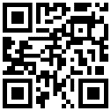
Contact Us!
LPTE Project Staff
Allison B. Taylor, ICI allison.taylor@umb.edu
Esther Kamau, ICI esther.kamau@umb.edu
Rowan DeAza, The Arc of GHN Rowan.DeAza@thearcofghn.org
Oliver Lyons, ICI oliver.lyons@umb.edu
Jennifer Bose, ICI jennifer.bose@umb.edu
LPTE.info
The contents of this presentation were developed under a grant from the Administration for Community Living (ACL), U.S. Department of Health and Human Services (HHS) (CFDA:93.631). The contents are those of the authors and do not necessarily represent the official views of, nor an endorsement by ACL, HHS, or the US Government.

